Slide 1
Principal component analysis(PCA) and linear discriminant analysis(LDA)

Slide 2
Principal component analysis(PCA)
PCA is a useful statistical technique (unsupervised learning algorithm) that has found application in fields such as face recognition and image compression, and is a common technique for finding patterns in data of high dimension.
PCA is a dimensionality reduction tool.
PCA being non-parametric method helps in extracting relevant information even for confusing dataset.
PCA gives valuable result when applied to liner algebra.

Slide 3
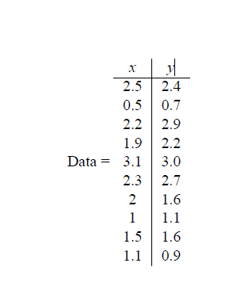
Method
Step 1: Get some data

Slide 4
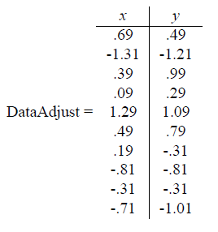
Step 2: Subtract the mean
For PCA to work properly, you have to subtract the mean from each of the data dimensions.
The mean subtracted is the average across each dimension. So, all the x values have x’ (the mean of the x values of all the data points) subtracted, and all the y values
have y’ subtracted from them.
This produces a data set whose mean is zero.

Slide 5


Step 3: Calculate the covariance matrix
Since the data is 2 dimensional, the covariance matrix will be 2x2.
An example. We’ll make up the covariance matrix for an imaginary 3 dimensional data set, using the usual dimensions x, y and z . Then, the covariance matrix has 3 rows and 3 columns, and the values are this:

Slide 6
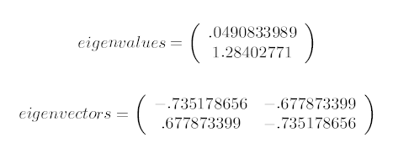
Step 4: Calculate the eigenvectors and eigenvalues of the covariance matrix
Since the covariance matrix is square, we can calculate the eigenvectors and eigenvalues for this matrix. These are rather important, as they tell us useful information about our data. I will show you why soon. In the meantime, here are the eigenvectors and eigenvalues:

Slide 7
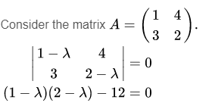


Calculate eigen values and eigen vectors
Write out the eigenvalue equation.
Set up the characteristic equation.

Slide 8




Substitute the eigenvalues into the eigenvalue equation, one by one. Put lambda =5
Row-reduce the resulting matrix. With larger matrices, it may not be so obvious that the matrix is linearly dependent, and so we must row-reduce. Here, however, we can immediately perform the row operation
The matrix above says that

Slide 9


Obtain the basis for the eigenspace
For lambda =5 and -2, eigen vector x₁ and x₂ are given by
Verify by putting the value of x and lambda in

Slide 10
In PCA, the main idea is to re-express the available dataset to extract the relevant information by reducing the redundancy and minimize the noise.
• We didn’t care about whether this dataset represent features from one or more classes, i.e. the discrimination power was not taken into consideration while we were talking about PCA.
• In PCA, we had a dataset matrix X with dimensions mxn, where columns represent different data samples.
• We first started by subtracting the mean to have a zero mean dataset, then we computed the covariance matrix S_{x} = XX^{T}.
• Eigen values and eigen vectors were then computed for S_{x}. Hence the new basis vectors are those eigen vectors with highest eigen values, where the number of those vectors was our choice.
• Thus, using the new basis, we can project the dataset onto a less dimensional space with more powerful data representation.

Slide 11
Linear discriminant
Linear Discriminant Analysis is a dimensionality reduction technique which is commonly used for the supervised classification problems.
It is used for modeling differences in groups i.e. separating two or more classes.
It is used to project the features in higher dimension space into a lower dimension space.

Slide 12

For example, we have two classes and we need to separate them efficiently.
Classes can have multiple features. Using only a single feature to classify them may result in some overlapping as shown in the below figure.
So, we will keep on increasing the number of features for proper classification.

Slide 13
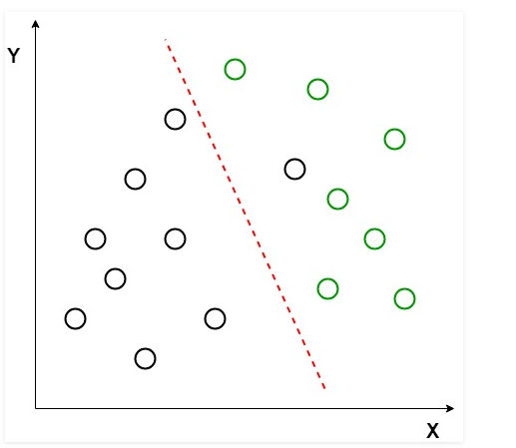
Example
Suppose we have two sets of data points belonging to two different classes that we want to classify. As shown in the given 2D graph, when the data points are plotted on the 2D plane, there’s no straight line that can separate the two classes of the data points completely.
Hence, in this case, LDA (Linear Discriminant Analysis) is used which reduces the 2D graph into a 1D graph in order to maximize the separability between the two classes.

Slide 14
Here, Linear Discriminant Analysis uses both the axes (X and Y) to create a new axis and projects data onto a new axis in a way to maximize the separation of the two categories and hence, reducing the 2D graph into a 1D graph.
Two criteria are used by LDA to create a new axis:
Maximize the distance between means of the two classes.
Minimize the variation within each class.

Slide 15
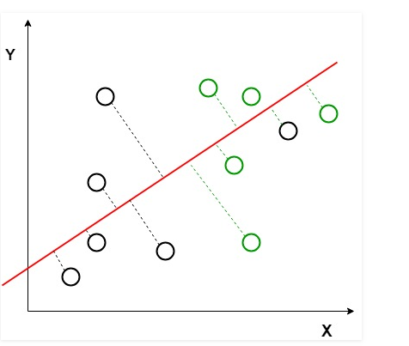

In the graph, it can be seen that a new axis (in red) is generated and plotted in the 2D graph such that it maximizes the distance between the means of the two classes and minimizes the variation within each class. In simple terms, this newly generated axis increases the separation between the points of the two classes.
After generating this new axis, all the data points of the classes are plotted on this new axis and are shown in the figure given below.

Slide 16
Applications:
Face Recognition: In the field of Computer Vision, face recognition is a very popular application in which each face is represented by a very large number of pixel values. Linear discriminant analysis (LDA) is used here to reduce the number of features to a more manageable number before the process of classification. Each of the new dimensions generated is a linear combination of pixel values, which form a template. The linear combinations obtained using Fisher’s linear discriminant are called Fisher faces.
Medical: In this field, Linear discriminant analysis (LDA) is used to classify the patient disease state as mild, moderate or severe based upon the patient various parameters and the medical treatment he is going through. This helps the doctors to intensify or reduce the pace of their treatment.

